Slide 1
Intro to Fabric CI/CD

Slide 2
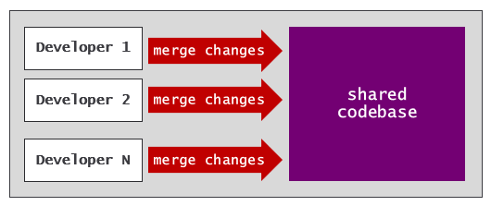
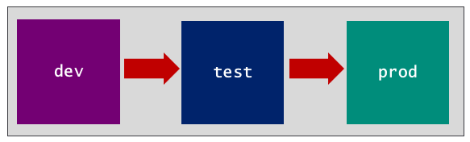
Motivation for CI/CD
What is CI/CD?
Continuous Integration (CI) is practice of frequently merging code changes to shared repository
Continuous Deployment (CD) is practice of automating deployment to target environments
CI provides development process where multiple work on same codebase at the same time
CD provides release process to move changes through a set of stages

Slide 3
Fabric Support for CI/CD
GIT Integration
Deployment pipelines
Variable Library
Workspace Item Types
Item Definitions
Fabric REST APIs

Slide 4
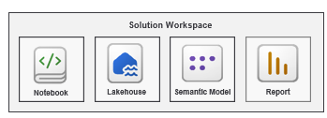
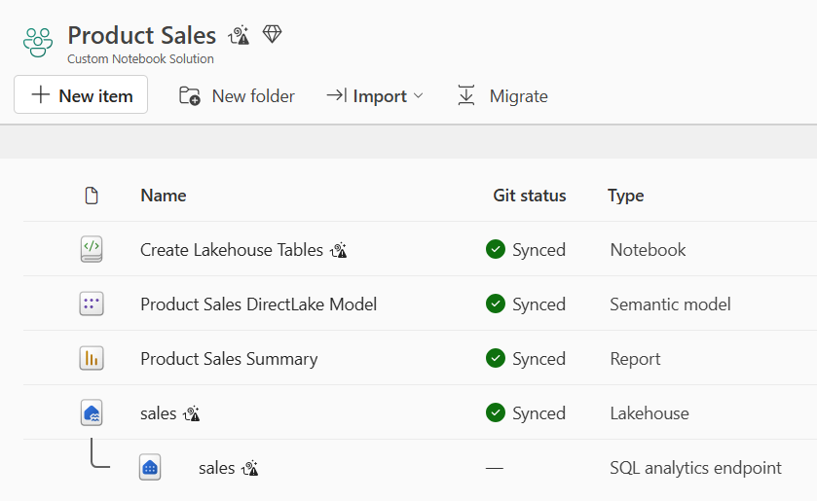
Example Fabric Solution - Product Sales
Workspace items are building blocks used to build Fabric solution
Example of a simple Fabric solution
Some Fabric solutions can be deployed to a single workspace
More complex Fabric solutions can be spread across multiple workspaces

Slide 5
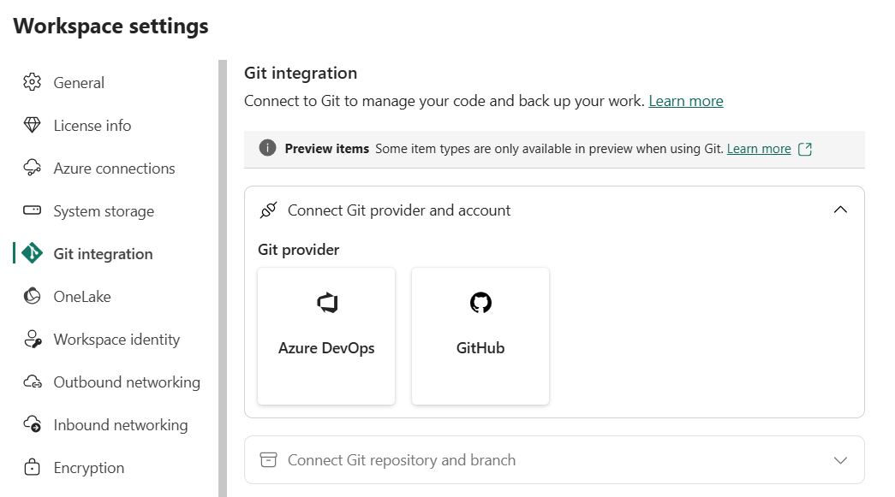
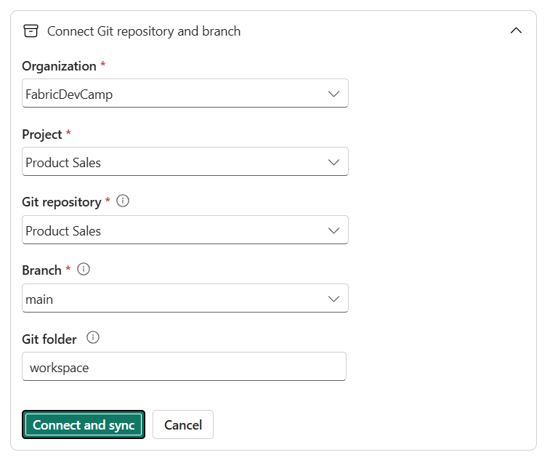
Fabric GIT Integration
Fabric supported GIT providers Azure DevOps, GitHub and GitHub Enterprise
Other GIT provides will be added over time
Fabric GIT integration enabled at workspace scope
Workspace is connected to branch in GIT repository

Slide 6
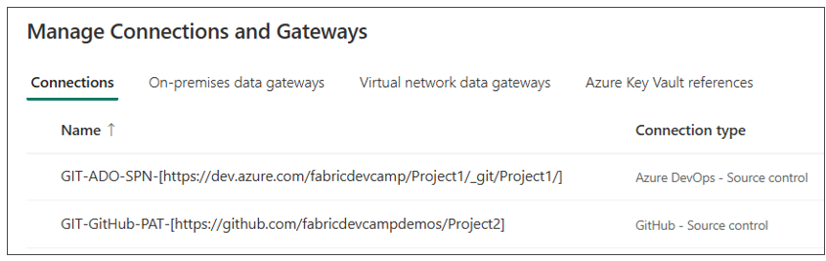
GIT Source Control Connections
Fabric provides GIT source control connectors for creating GIT connections
Azure Dev Ops source control connection can be created using service principal credentials
GitHub source control connection must be configured using a personal access token (PAT)
Source control connection has path to repository - not to a specific branch
You can reuse single source control connection to connect N branches to N workspaces

Slide 7
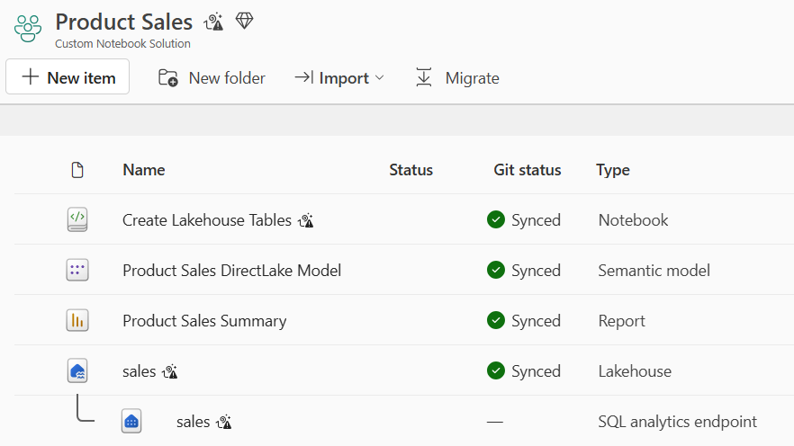
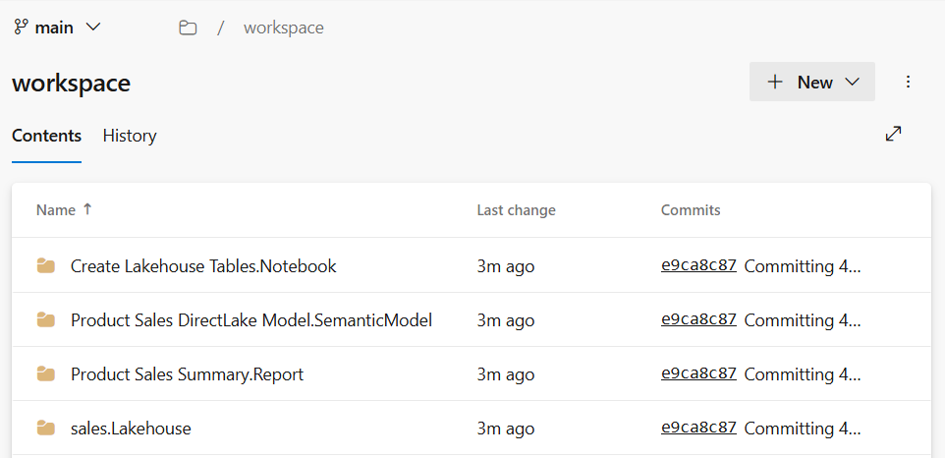
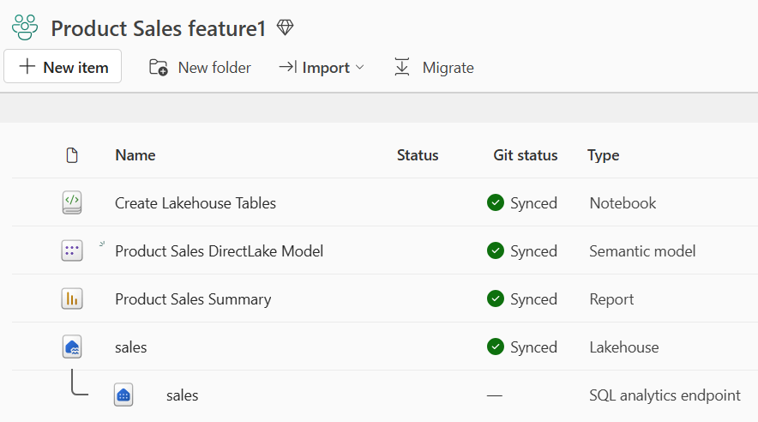
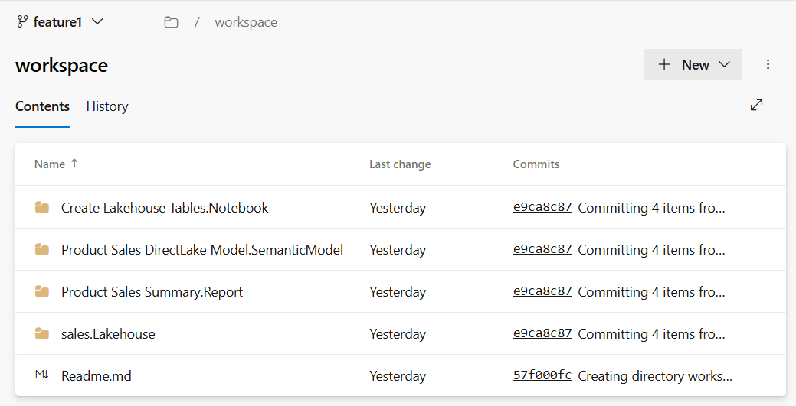
Serialization of Workspace Items to Item Definitions
When you connect workspace to GIT branch…
Fabric GIT integration serializes workspace item definitions and writes definition files to branch
Fabric GIT integration can create/update workspace items from item definitions in GIT branch
Commit to GIT
Update from GIT

Slide 8
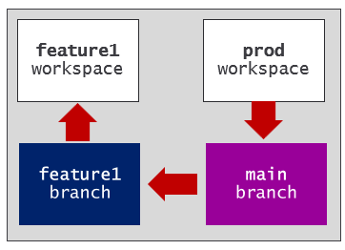
Feature Workspaces
New feature workspace can be initialized using Update from GIT operation
GIT synchronization creates matching set of workspace items
Feature workspace provides isolated environment for development work
Workspace items might need modification before workspace is ready
You might need to run pipeline/notebook to populate lakehouse with data
You might need to to create connection to bind semantic model to datasource

Slide 9
Development Process for Contiguous Integration
Feature workspaces provide recommended approach for development
Feature branches must be paired with feature workspace
Release branch is shared branch where all changes are merged together
Feature branches should be just lived to avoid merge release branch conflicts
feature 1
workspace
feature 1
branch
pull request
release
branch
Commit to GIT
feature 2
workspace
feature 2
branch
pull request
Commit to GIT
feature N
workspace
feature N
branch
pull request
Commit to GIT

Slide 10
High-level Overview of End-to-End Workflows for CI/CD
Simple CI/CD workflow with main as release branch
More intricate CI/CD workflow with dev as the release branch
Prod
workspace
feature
workspace
feature
branch
main
branch
feature
workspace
feature
branch
Dev
workspace
Test
workspace
Prod
workspace
feature
workspace
feature
branch
dev
branch
test
branch
main
branch
feature
workspace
feature
branch

Slide 11
Deployment Pipelines
Deployment pipelines provide a continuous deployment mechanism
Deployment pipeline manages the lifecycle of workspace items across stages
Each stage represents a specific environment implemented using a Fabric workspace
Fabric Deployment Pipeline
dev
workspace
test
workspace
prod
workspace
Deploy
Deploy

Slide 12
Integrating GIT Sync with Deployment Pipeline
GIT integration and deployment pipeline used together for end-to-end CI/CD workflow
CI provides by GIT integration
CD provided by deployment pipeline
Fabric Deployment Pipeline
dev
workspace
test
workspace
prod
workspace
Deploy
Deploy
GIT
SYNC
feature
workspace
feature
branch
main
branch
feature
workspace
feature
branch

Slide 13
Variable Library
Variable library create as a set of variables
Each variable defined with name, type and default value
Other types of workspace items are able to read variable values
Getting all types of workspace items to support variable library is work in progress
Variable Name | Type | Default Value
database_server | String | devcamp.database.windows.net
database_name | String | product-sales-dev
workspace
Notebook
Pipeline
Variable Library
Copyjob
var1 - string - 'foo'
var2 - string - 'bar'
var3 - integer - 42
Dataflow
OneLake Shortcut

Slide 14
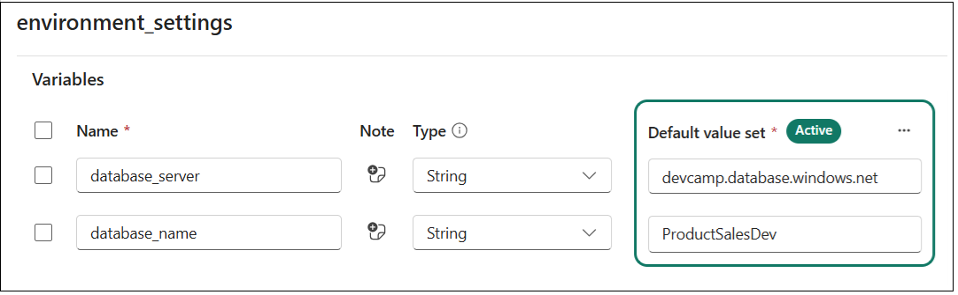
Motivation for a Parameterization Strategy
Consider classic scenario where each stage connect to different database
Start by creating variable library with variables with connection settings
dev
workspace
test
workspace
prod
workspace

Slide 15
Extending Variable Library with Value Sets
Variable library can be extended with value sets
Each workspace has setting to active value set
Variable Library
Value Sets
Variable Name | Type | Default Value
database_server | String | dev value
database_name | String | dev value
test
test value
test value
prod
prod value
prod value
dev workspace
test workspace
prod workspace
Variable Library
Variable Library
Variable Library
dev value set (active)
test value set
prod value set
dev value set
test value set (active)
prod value set
dev value set
test value set
prod value set (active)

Slide 16
Workspace Item Type Capabilities for CI/CD
CI/CD capabilities that are supported by some but not all workspace item types.
Support for reading variables from a variable library
Support with Fabric REST APIs to create and update items using item definitions
Support for calling Fabric APIs using a Service Principal identity
Support for auto-binding workspace item dependencies

Slide 17
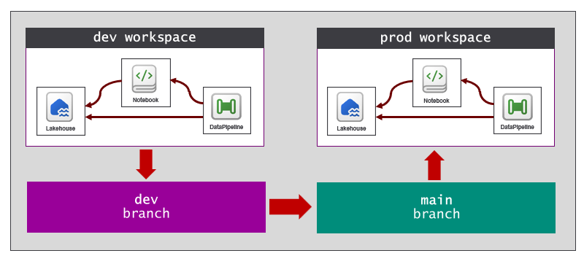
Auto-bind behavior
Come workspace item types self-manage their relations to other workspace items
For example, pipelines support auto-binding behavior
notebooks will support auto-binding behavior soon
You might encounter workspace item types that do not yet support auto-binding.
When you encounter workspace item types that do not support auto-binding…
required to run a post-sync job script to correctly reestablish relations to other workspace items.

Slide 18
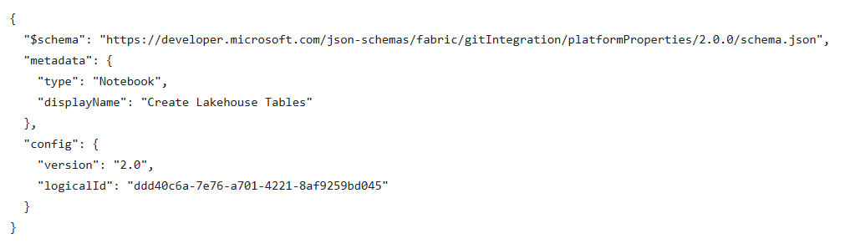
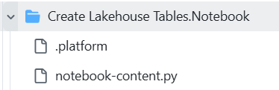
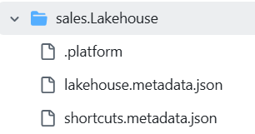
Item Definition Files
item definition is set of files that contain the metadata for workspace item instance
All item definitions contain common platform file name .platform
Files required and/or allowed in item definition determined by workspace item type

Slide 19
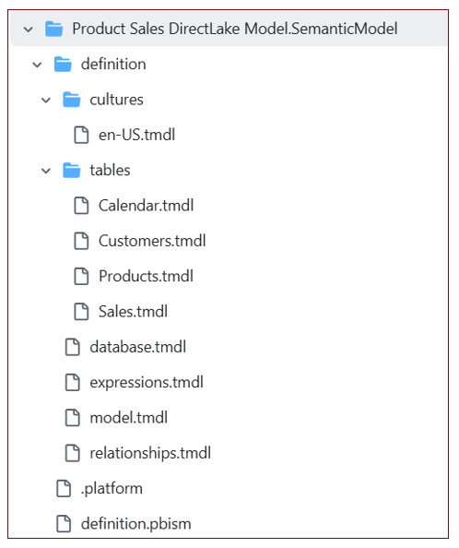
Semantic Model Item Definition
Some workspace item types can have item definitions that are far more complex
Item definition for a semantic model can include dozens or even hundreds of TMDL files
More files in item definitions results in more granularity in CI/CD development process

Slide 20
Automation in Fabric CI/CD project
Public Microsoft APIs used for automation in Fabric CI/CD
Fabric REST APIs provides the ability to create workspaces, connections and workspace items
Azure Microsoft Fabric REST API provides the ability to create and manage Fabric capacities
Power BI REST API fills some gaps in scenarios for updating semantic models and reports
What are options for writing automation logic?
Use Terraform for automating of creating tenant-level resources
Use Fabric CLI for easiest path to writing automation logic with Fabric REST APIs
Call Fabric REST APIs directly when greater control is preferred or required
Leverage fabric-cicd Python library to implement API-driven release process

Slide 21
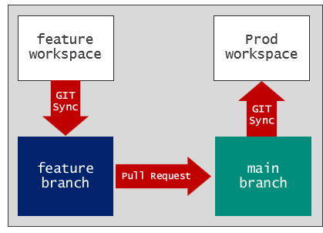
Automation Required After Update-from-GIT Operation
Automation often required after Update from GIT operation completes
Workspace items need modification before workspace is ready for use
Post-deploy jobs run only once after an empty workspace is first initialized
Post-sync jobs run each time after an Update from GIT operation completes on a workspace
Updates required for workspace items that do not support auto-binding
Updates required for workspace items that do not support variable libraries

Slide 22
What are options for writing automation logic?
Use Terraform for automating of creating tenant-level resources
Used to create tenant-level resources for Fabric CI/CD project
Based on best practice of Infrastructure as Code (IaC)
Use Fabric CLI for easiest path to writing automation logic with Fabric REST APIs
Acts as façade to Fabric REST APIs to boost productivity
Program using Fabric REST APIs when greater control is preferred or required
Provides ability to work directly with items definition
Significant complexity makes it a good fit for professional developers - but not for others
Leverage fabric-cicd Python library to implement API-driven release process
Eliminates need to implement a deployment process using Fabric REST APIs
Provide built-in code to implement full release process for contiguous deployment

Slide 23
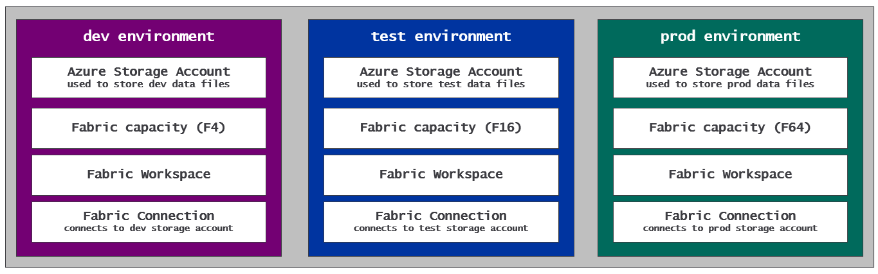
Using Terraform for Fabric CI/CD project setup
Terraform is an open-source tool built on the principles of infrastructure as code (IaC)
Infrastructure defined using configuration files instead manual processes or procedural code
Used during project setup to create tenant-level items - workspace, capacities, connections, etc
Terraform deployment process is versionable and repeatable
Example of Fabric CI/CD project resources deployed using Terraform
Terraform providers available for creating Azure resources such as Azure storage account
Fabric provider for Terraform makes it possible to create Fabric tenant level items

Slide 24
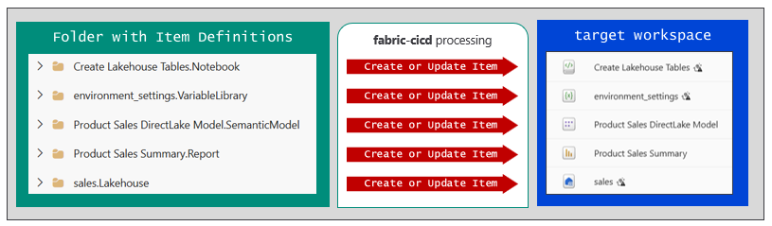
The fabric-cicd Python Library
fabric-cicd library provide wrapper on Fabric REST APIs
Provides reusable library of code for implementing a release process
Deploys from folder of item definitions to set of items in target workspace
Built-in code handles all Fabric REST API programming

Slide 25
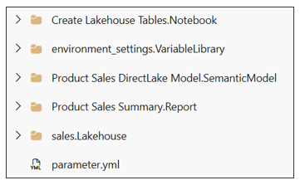
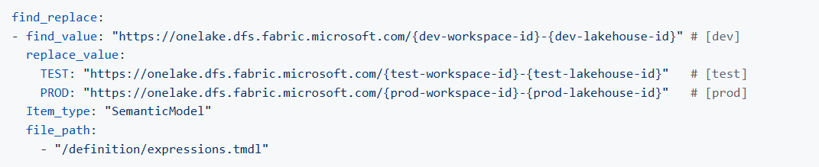
Parameterization with fabric-cicd
Parameterization allows updates to item definition files on the fly
Parameterization required to deal with environment-specific settings committed to GIT
Parameterization enabled by adding parameter.yml file to root folder
Parameterization used to update item definition files using substitution patterns (e.g. find-replace)

Slide 26
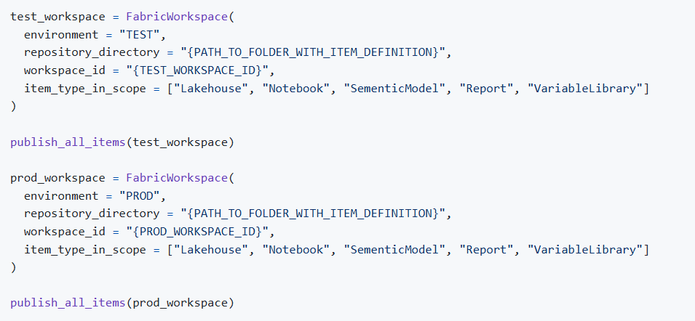
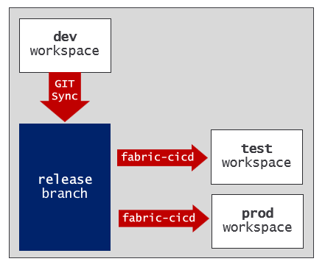
Python Code for fabric-cicd Deployment
Create FabricWorkspace object and call publish_all_items - that's it!
fabric-cicd provides flexibility of one-to-many between GIT branch and workspaces

Slide 27
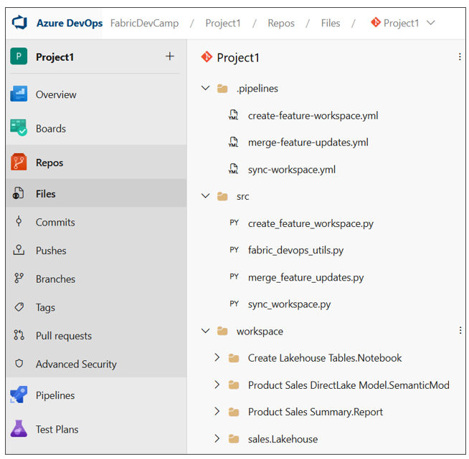
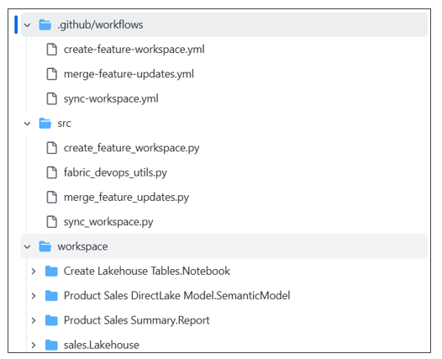
Developing CI/CD Workflows using GIT Provider
Fabric CI/CD workflows developed using support in cloud-based GIT provider
If using Azure Dev Ops, workflows developed using Azure Pipelines
If using GitHub, workflows developed using GitHub Workflow Actions

Slide 28
Option 1: Release process using Deployment Pipeline
GIT integration and deployment pipeline used together for end-to-end CI/CD workflow
CI provides by GIT integration
CD provided by deployment pipeline
Fabric Deployment Pipeline
dev
workspace
test
workspace
prod
workspace
Deploy
Deploy
GIT
SYNC
feature
workspace
feature
branch
main
branch
feature
workspace
feature
branch

Slide 29
Option 2: Release process using GIT Sync
You need to create or reuse existing Fabric workspace for each GIT branch
The challenge is managing dependencies between workspace items
feature1
workspace
dev
workspace
prod
workspace
GIT
SYNC
GIT
SYNC
GIT
SYNC
feature1
dev
main
PR
PR

Slide 30

Option 3: Release process using fabric-cicd (multi-branch)
You need to create or reuse existing Fabric workspace for each GIT branch
The challenge is managing dependencies between workspace items
feature1
workspace
dev
workspace
test
workspace
prod
workspace
GIT
SYNC
GIT
SYNC
fabric
cicd
fabric
cicd
feature1
dev
test
main
Pull
Request
Pull
Request
Pull
Request

Slide 31
Option 4: Release process using fabric-cicd (single-branch)
Dev
workspace
GIT SYNC
feature1
workspace
GIT SYNC
feature1
branch
merge with PR
main
branch
fabric_cicd
Test
workspace
feature2
workspace
GIT SYNC
feature2
branch
merge with PR
fabric_cicd
Prod
workspace

Slide 32
Option 5: Release process using fabric-cicd (multi-tenant)
Dev
workspace
Tenant 1
workspace
GIT SYNC
feature1
workspace
feature1
branch
fabric-cicd
GIT SYNC
merge with PR
main
branch
Tenant 2
workspace
fabric-cicd
feature2
workspace
GIT SYNC
feature2
branch
merge with PR
fabric-cicd
Tenant 3
workspace

